Slide 1
Ignacio Acevedo - Ignacio Barría - Daniel Carrasco – Kevin Johnson
Pulp and Paper Business Logistics

Slide 2
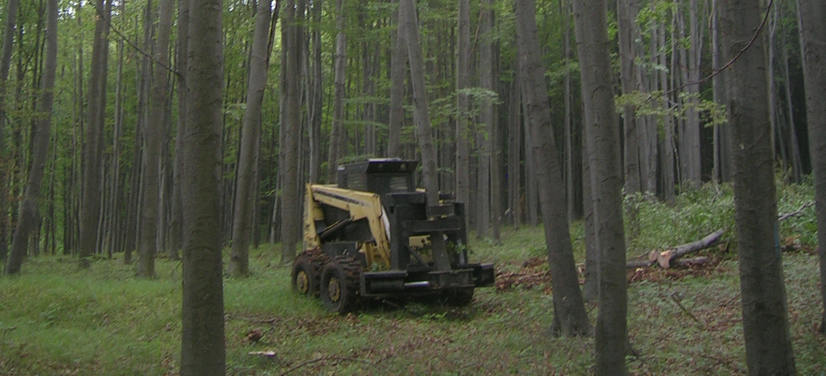
Introduction

Slide 3

Pulp and Paper Business
Context and problems
Assumptions and limits
Simulation purpose and KPI

Slide 4
Pulp and Paper Business
Context and problems
Assumptions and limits
Simulation purpose and KPI

Slide 5
Uncoordinated operation and suboptimal operation policy
Climatic problems of the region
High inventory and transport costs

Slide 6
Pulp and Paper Business
Context and problems
Assumptions and limits
Simulation purpose and KPI

Slide 7
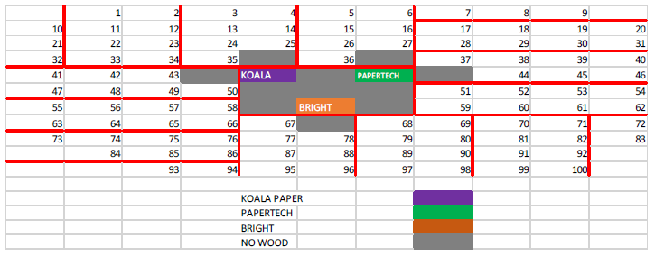
Distribution of logging operations and mills

Slide 8
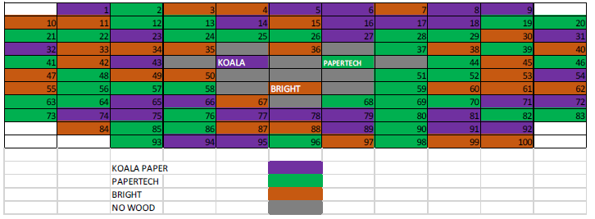
Operation assignment

Slide 9
Unknown distributions
Forests rate of growth
Amount of hours of daylight

Slide 10
Pulp and Paper Business
Context and problems
Assumptions and limits
Simulation purpose and KPI

Slide 11
Estimate inventory and transport costs
Detect failures and generate an alternative operation policy
Test the new operation policy

Slide 12
Main KPI (for base and improved model)

Slide 13

Conceptual Model (base)

Slide 14

Base model
Entities that flow through the system
Random input variables
Resources and capabilities

Slide 15
Base model
Entities that flow through the system
Random input variables
Resources and capabilities

Slide 16
The only entity is ‘Camion’ (Truck)
Has a parameter for the amount of wood
The rest of the characteristics we know (speed, etc.)

Slide 17
Base model
Entities that flow through the system
Random input variables
Resources and capabilities

Slide 18
The amount of wood when loading a truck
Amount consumed by each mill
Days with bad weather (not workable)

Slide 19
Base model
Entities that flow through the system
Random input variables
Resources and capabilities

Slide 20
Inventory capacity
Number of trucks per logging operation
Initial inventory

Slide 21
Base model
Operation policy
Main events

Slide 22
Base model
Operation policy
Main events

Slide 23
The maximum daily quantity of full trucks
Trucks are loaded when an order is received
Days off

Slide 24
Mills know the demand for wood at the beginning of the day
How the demand is decided
How demand is distributed during the day

Slide 25
What happens when stock-out occurs

Slide 26
Base model
Operation policy
Main events

Slide 27
Associated with the arrival and departure of a truck
When a crane needs maintenance
When stock-out and penalties occur

Slide 28
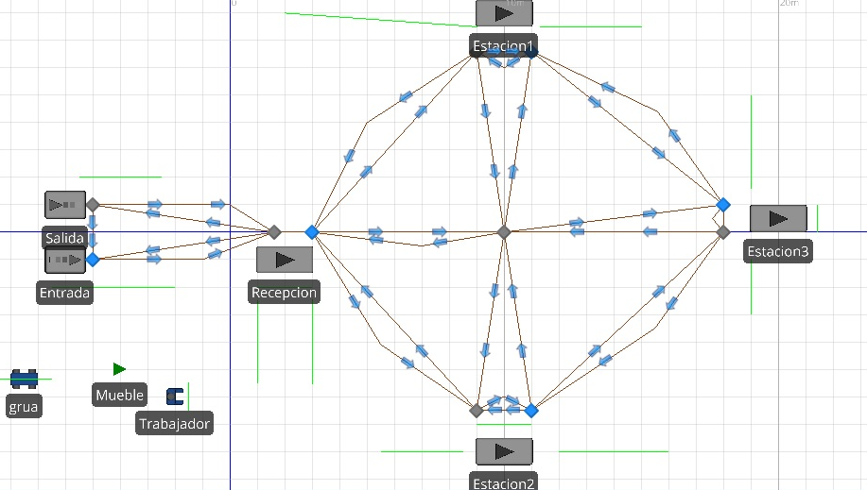
Simio Model

Slide 29


Model
Idea
Operation environment
Locations and roads

Slide 30
Model
Idea
Operation environment
Locations and roads

Slide 31
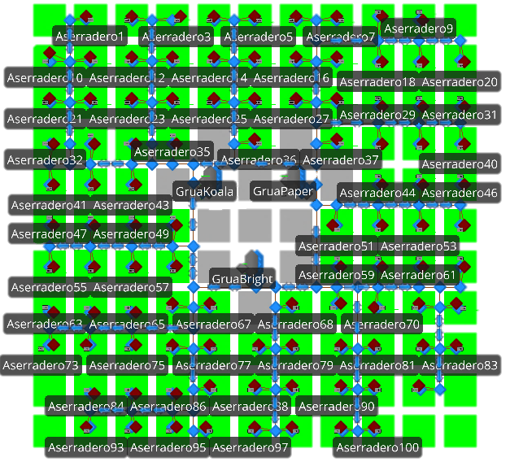

Slide 32
Model
Idea
Operation environment
Locations and roads

Slide 33
Weather
Forest conditions
Days off

Slide 34
Model
Idea
Operation environment
Locations and roads

Slide 35

Mills
Paths
Logging operations

Slide 36
Model
Mills and hardwood demand
Logging operations
Trucks and wood

Slide 37
Model
Mills and hardwood demand
Logging operations
Trucks and wood

Slide 38
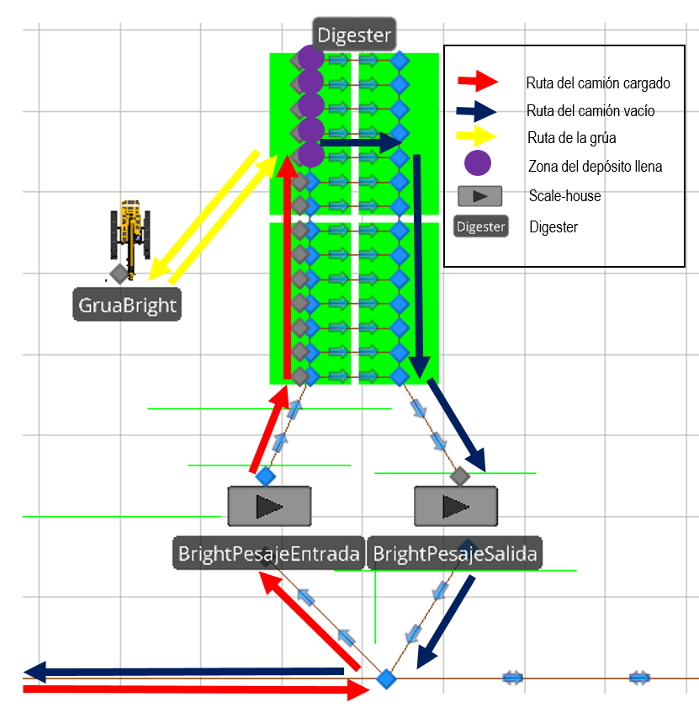

Slide 39
Model
Mills and hardwood demand
Logging operations
Trucks and wood

Slide 40
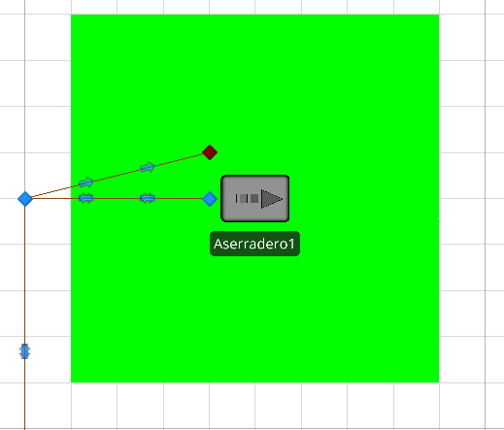

Slide 41
Model
Mills and hardwood demand
Logging operations
Trucks and wood

Slide 42
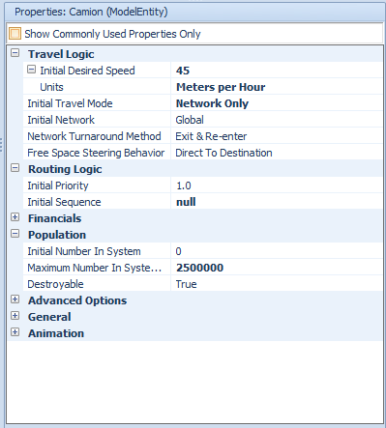
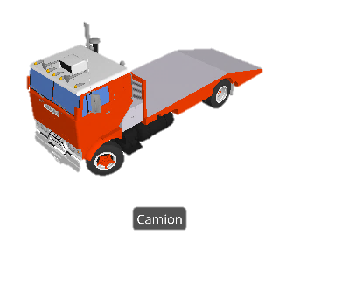

Slide 43
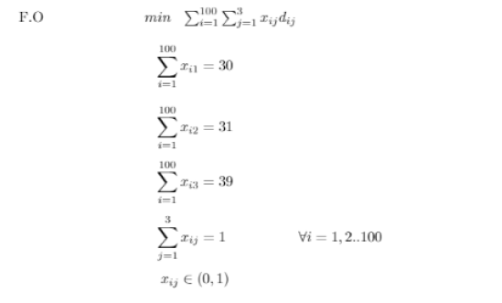
Improved Conceptual Model

Slide 44
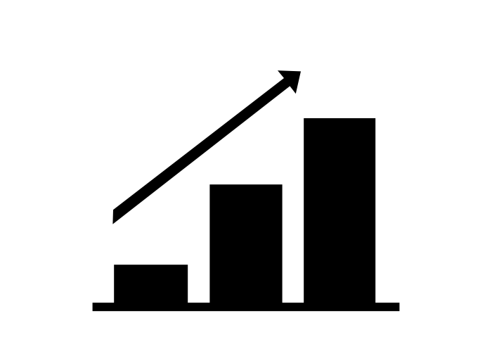
Improved model
Improvements in storage costs
Improvements in transport costs
Stockout prevention

Slide 45
Improved model
Improvements in storage costs
Improvements in transport costs
Stockout prevention

Slide 46
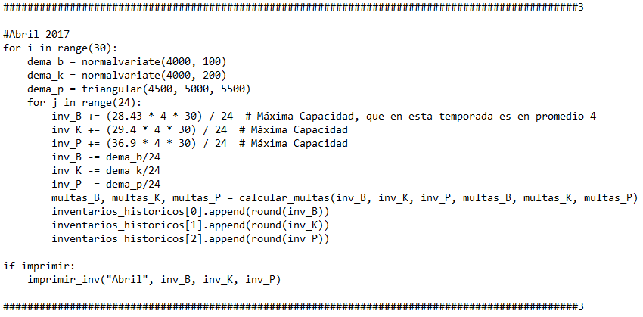

Slide 47
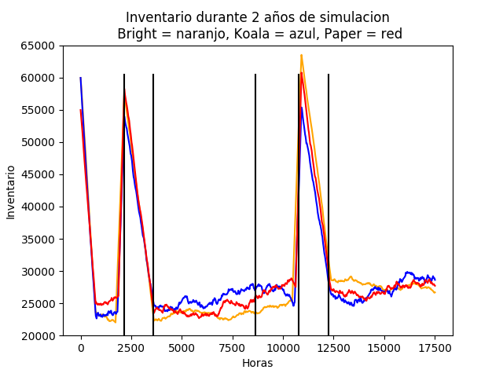

Slide 48
Improved model
Improvements in storage costs
Improvements in transport costs
Stockout prevention

Slide 49
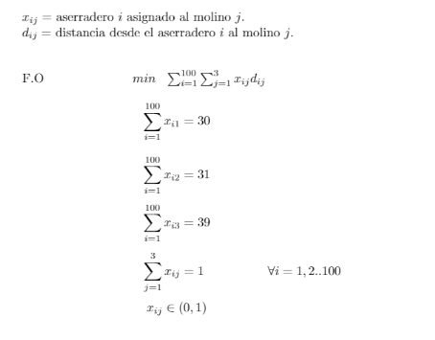

Slide 50
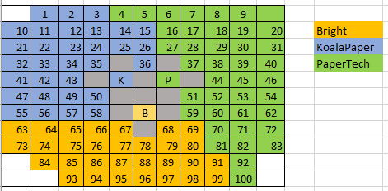

Slide 51
Improved model
Improvements in storage costs
Improvements in transport costs
Stockout prevention

Slide 52
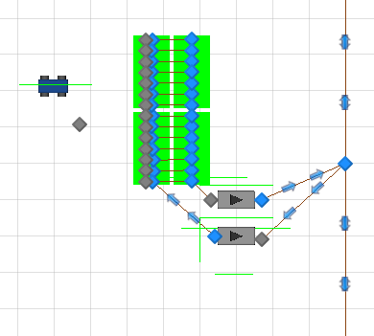
Improved Simio Model

Slide 53
Model
Demand and storage changes
Transport changes
Stockouts policy

Slide 54
Model
Demand and storage changes
Transport changes
Stockouts policy

Slide 55
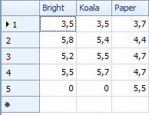

Slide 56
Model
Demand and storage changes
Transport changes
Stockouts policy

Slide 57
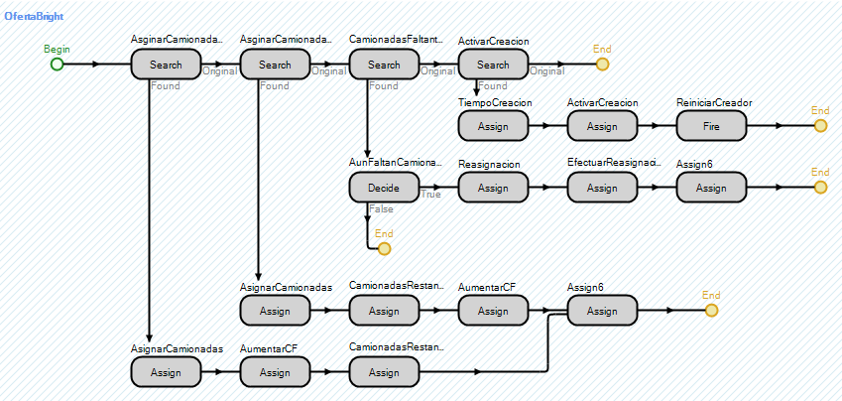

Slide 58
Model
Demand and storage changes
Transport changes
Stockouts policy

Slide 59
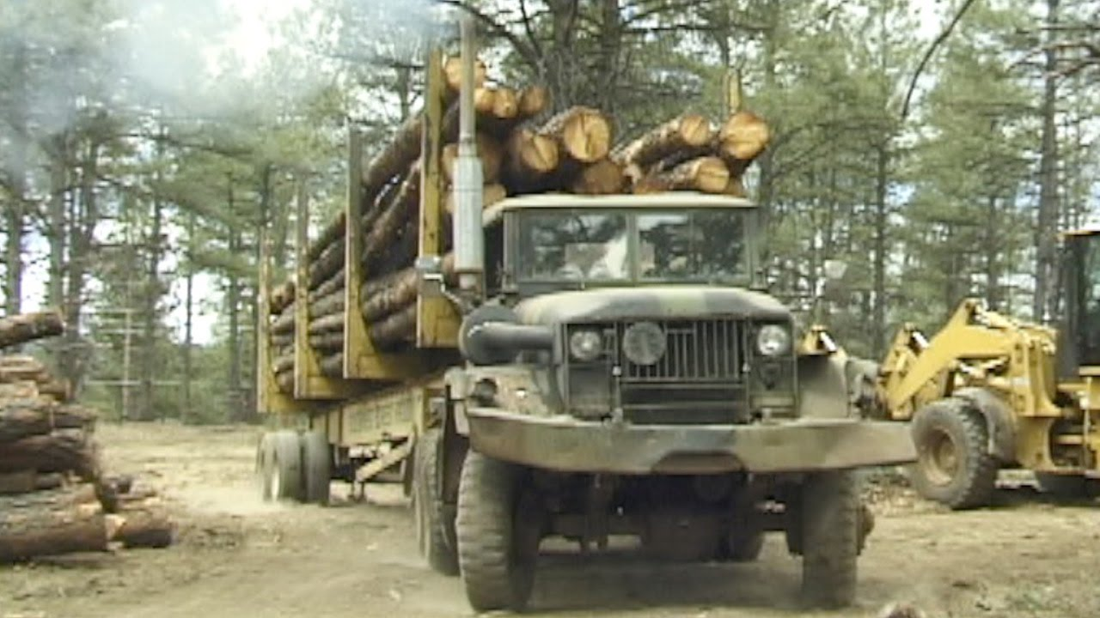
Results and model validation

Slide 60
AQUÍ VA LA TABLA CON LOS RESULTADOS

Slide 61

Model validation
Transport costs estimation
Inventory costs estimation
Amount of wood cut

Slide 62
Model validation
Transport costs estimation
Inventory costs estimation
Amount of wood cut

Slide 63
Model validation
Transport costs estimation
Inventory costs estimation
Amount of wood cut

Slide 64
Model validation
Transport costs estimation
Inventory costs estimation
Amount of wood cut

Slide 65

Conclusions

Slide 66
Conclusions
Logistics and business sugestions
Posible future improvements

Slide 67
Conclusions
Logistics and business sugestions
Posible future improvements

Slide 68
Conclusions
Logistics and business sugestions
Posible future improvements

Slide 69






Questions
Questions

